Slide 1
CATAGORIZE INSTAGRAM POSTS BASED ON LOCATION #TAGS
TEAM 4
Pradeep Margasahayam Prakash, Pramod Kadagattor,
Puneet Dravid

Slide 2
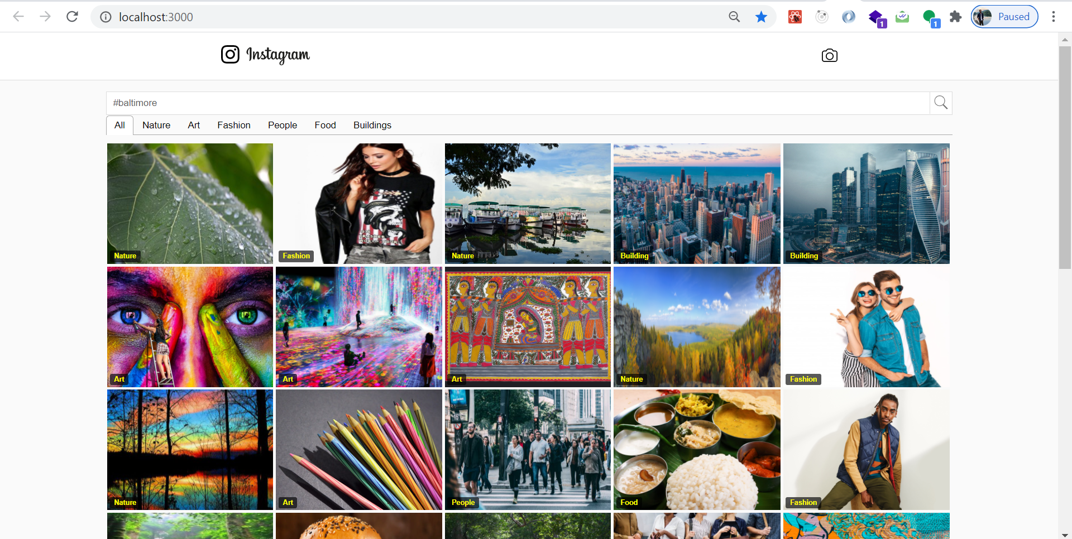
RECAP: DESCRIPTION
Web-application where user can search on a location-based hashtag and get categorized images.
Implement Load Balancing on ML based Categorized Instagram posts.
API endpoint which can be consumed by any user.
Auto scale the instances on AWS.

Slide 3
RECAP: TECH-STACK
Frameworks and libraries -
Python- Flask, Selenium, React Redux, Bootstrap
Computing Services -
AWS EC2, S3, AMIs for auto configuring the resources
API Services -
AWS API Gateway
AWS Sagemaker (ground truth), AWS Rekognition
Notes:
Dataset: Pima Indians Diabetes Dataset
Derived from The National Institute of Diabetes and Digestive and Kidney Diseases (part of NIH).
Consists of several medical predictor variables and one target variable.
Application/Service Creation: Flask
Micro web framework written in Python.
Fun fact: LinkedIn and Pinterest makes use of Flask framework.
Cloud Computing: Heroku <Tentative>
Host the website on the cloud.
Make use of Heroku - a cloud Platform as a service (Paas).

Slide 4
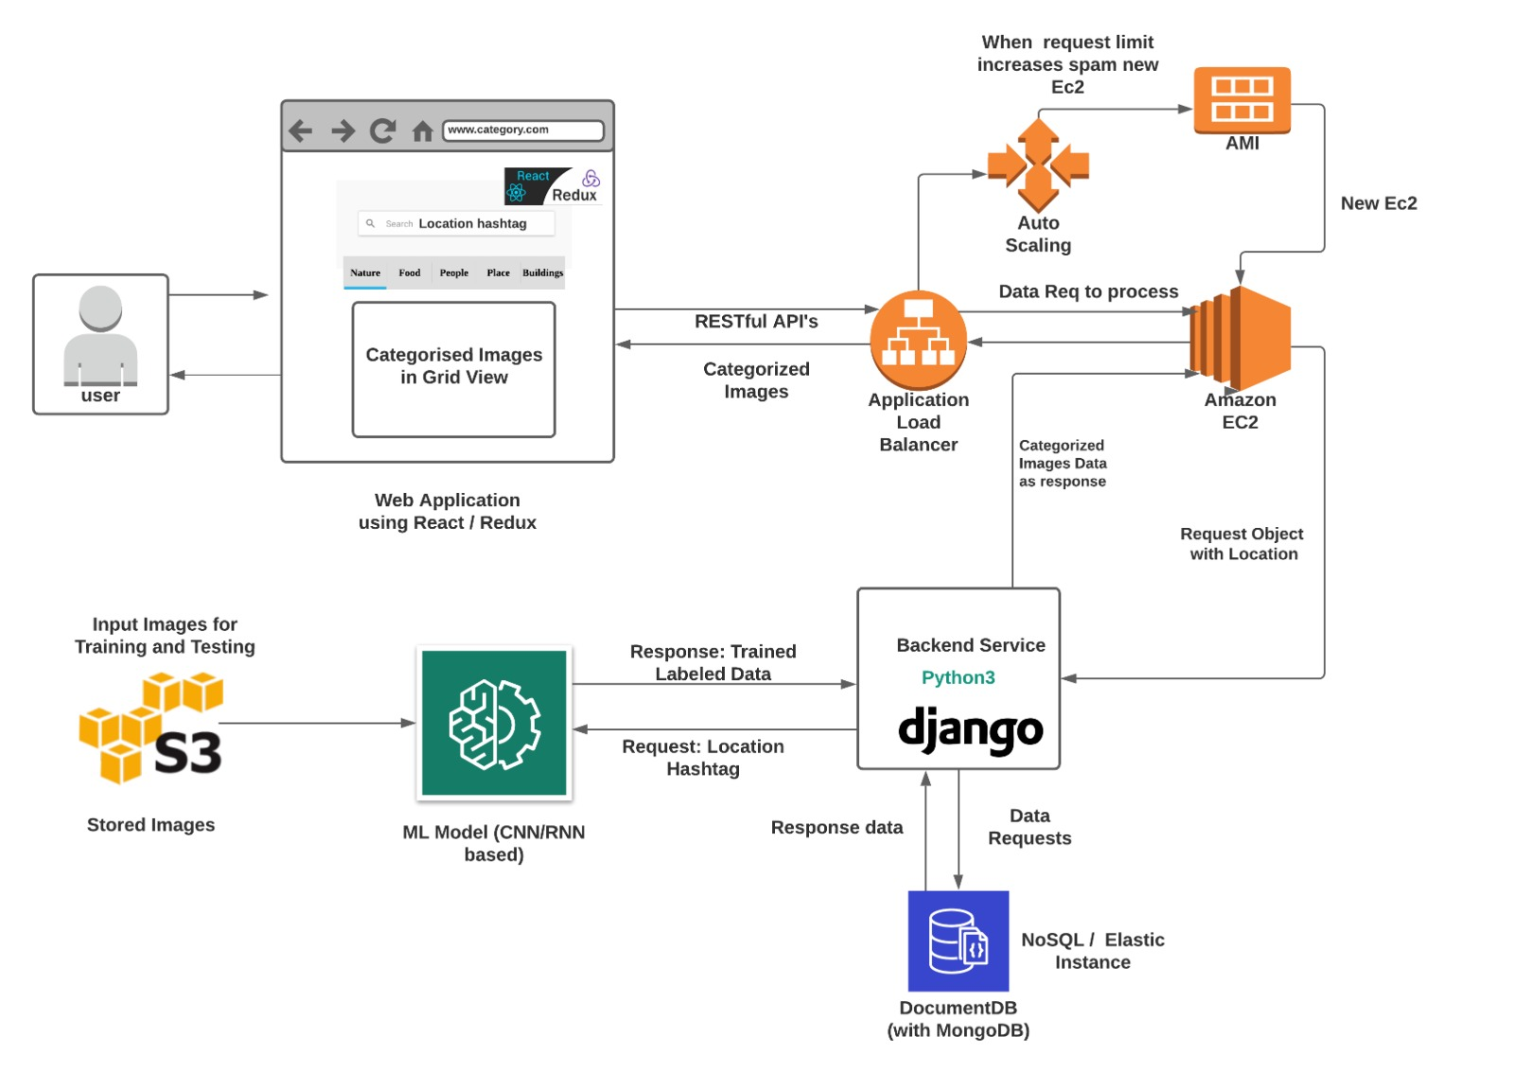
RECAP: ARCHITECTURE

Slide 5
RESPONSIBILITIES
Design | UI / UX | Pradeep
 | Database (Mongo and S3 instance) | Pradeep, Pramod, Puneet
 | REST APIs / ALB and Autoscaling | Pramod, Pradeep, Puneet
 | ML Prototype Model | Puneet, Pramod
Develop | UI / UX | Pradeep
 | Rest APIs / ALB and Autoscaling | Pramod, Puneet
 | Model training and testing | Pramod, Puneet
Integration and Testing | End to end integration and functional / user testing. (Feature stress) | Pradeep, Pramod, Puneet
Documentation | Final IEEE paper | Pradeep, Pramod, Puneet

Slide 6

ROADMAP REVIEW
● Initial
○ Designing Architecture
○ Analyze available AWS services
○ Designing UI/UX
○ Identify data collection using Instagram API / web-scraping
● Mid-Term
○ Prototyping ML Model
○ Develop UI components
○ Creating backend API endpoint with REST format
● Final
○ Deploying ML Model on AWS
○ Auto Scale instance and Implement Load Balancer
○ Integrate and Test

Slide 7
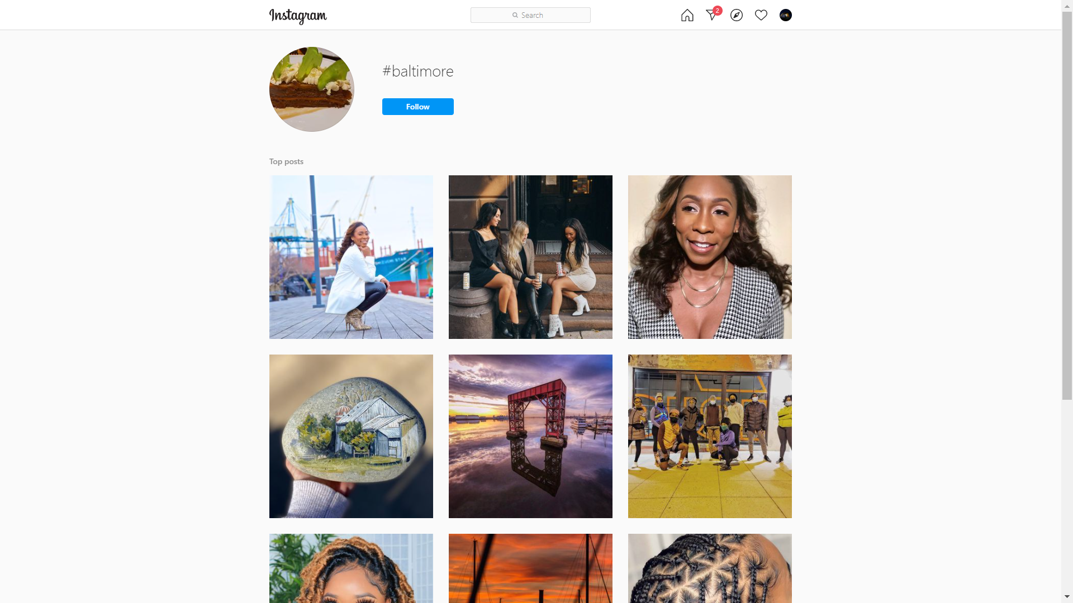
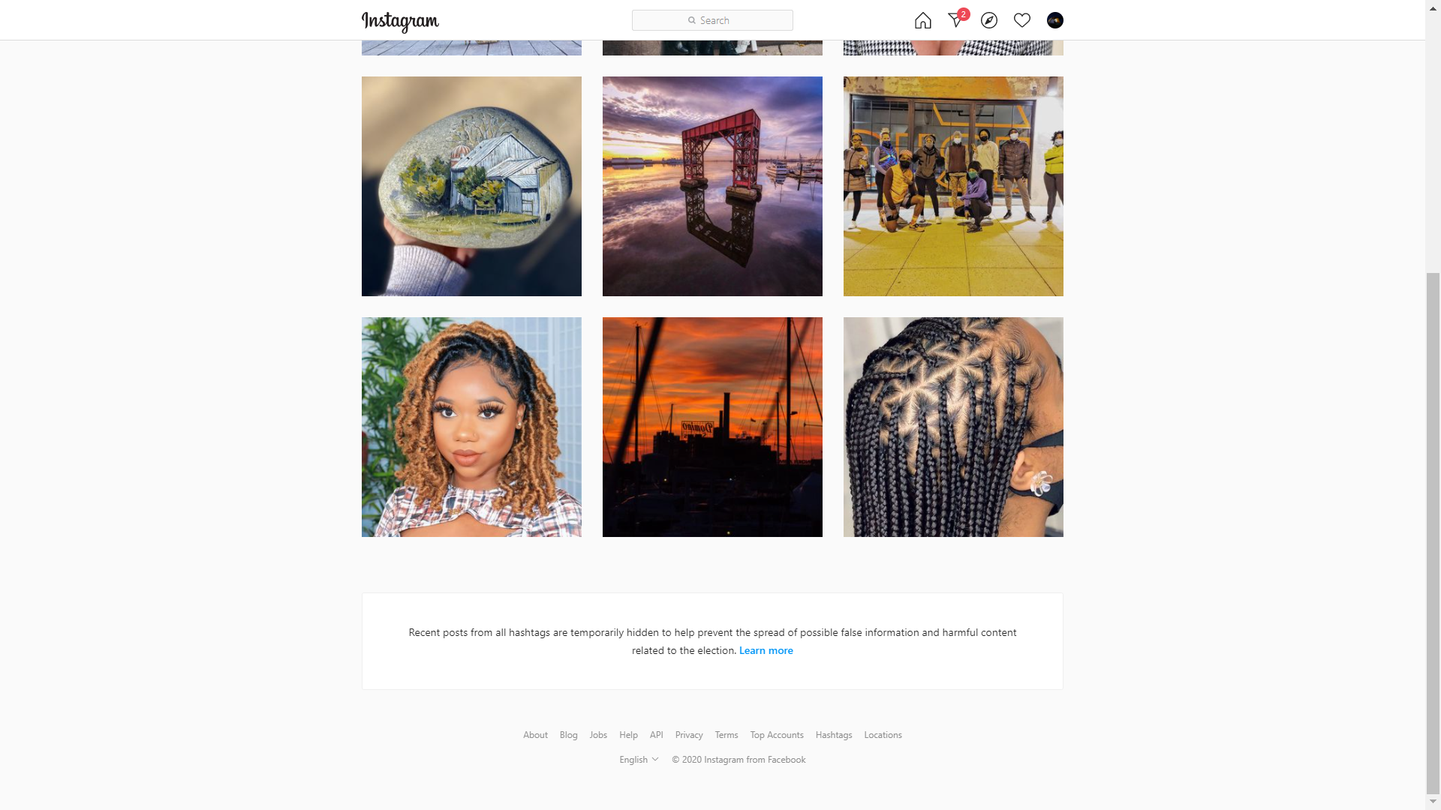
DATA COLLECTION / PRE-PORCESSING
Issues with Top/ Recent Media Instagram APIs:
Allows only 30 searches for 7-day period.
To get public access of Instagram posts, the application needs to be submitted to Instagram for verification, before integrating with their APIs. Also, the application needs to be consumed through two or more endpoints.

Slide 8
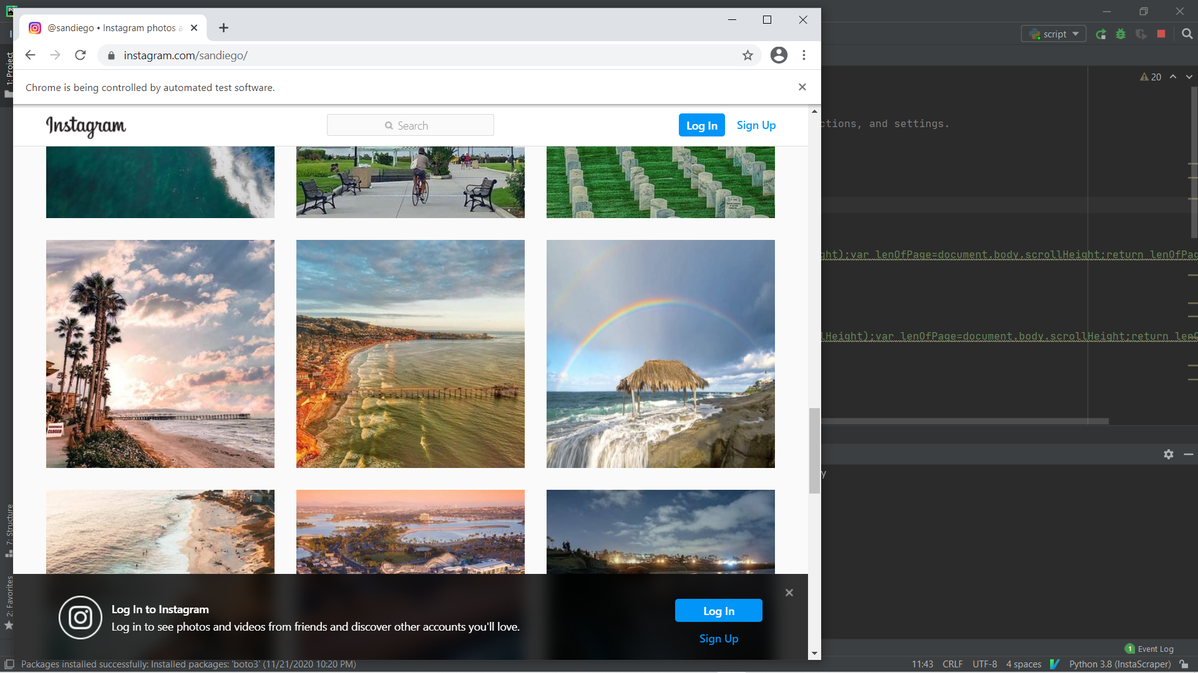
DATA COLLECTION / PRE-PORCESSING
Beautiful soup for web-scraping the images from Instagram:
Using Selenium and Beautiful Soup to web-scrape images from Instagram.
Download images along with the hashtags from data frame.

Slide 9
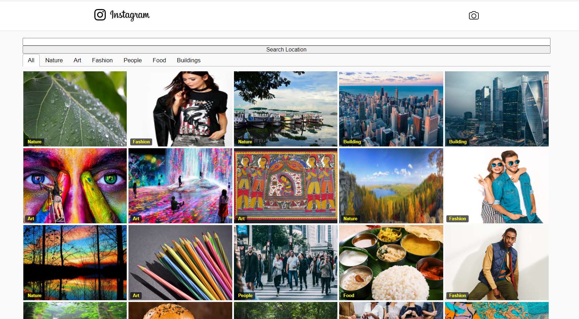
SCREENSHOTS:
Main Page with location based #tag searched.

Slide 10
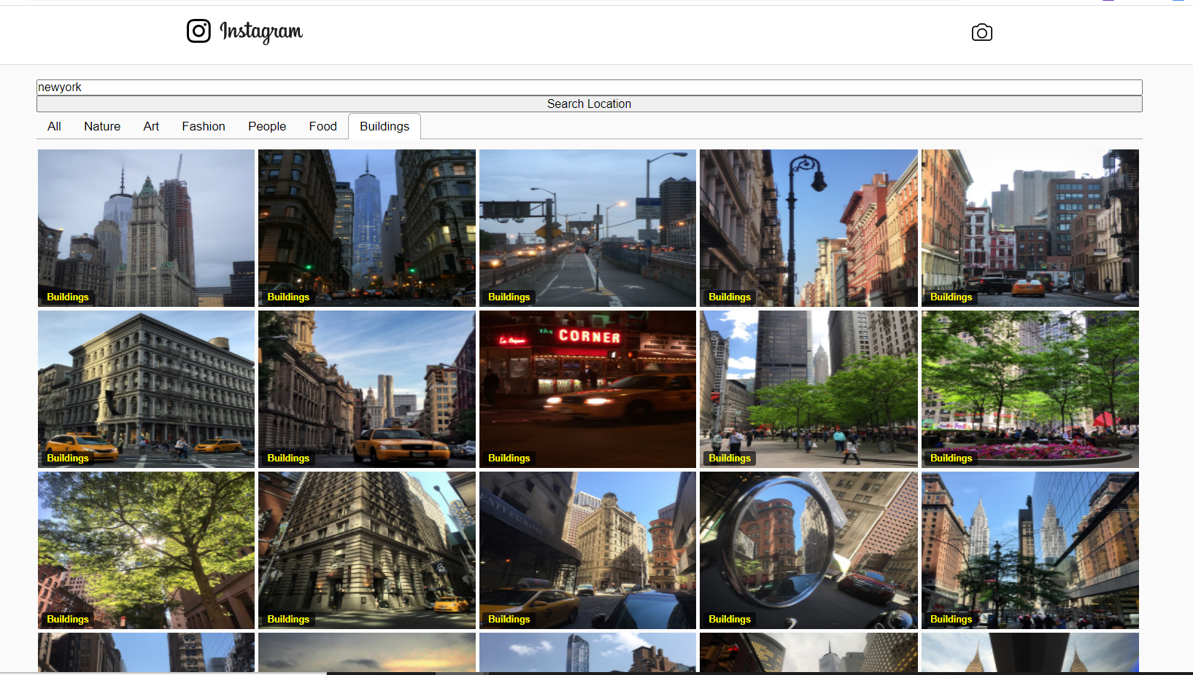
SCREENSHOTS:
Images segregated based of categories.

Slide 11
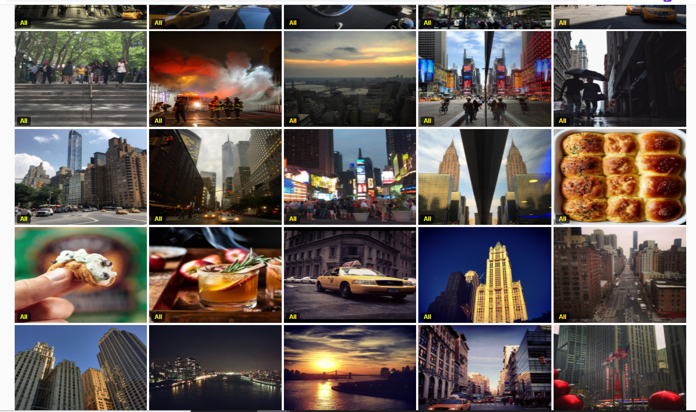
SCREENSHOTS: Showing All Images in Newyork

Slide 12
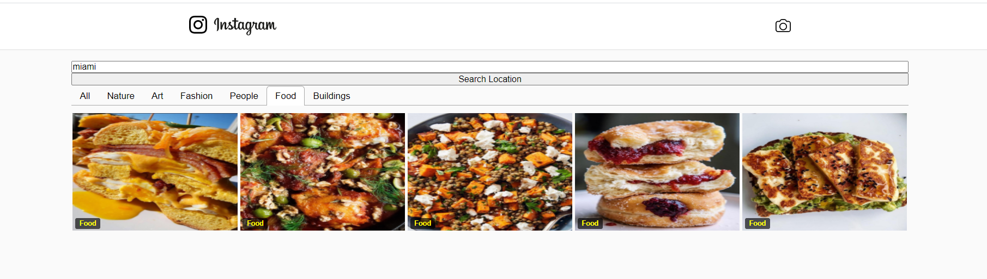
SCREENSHOTS:

Slide 13
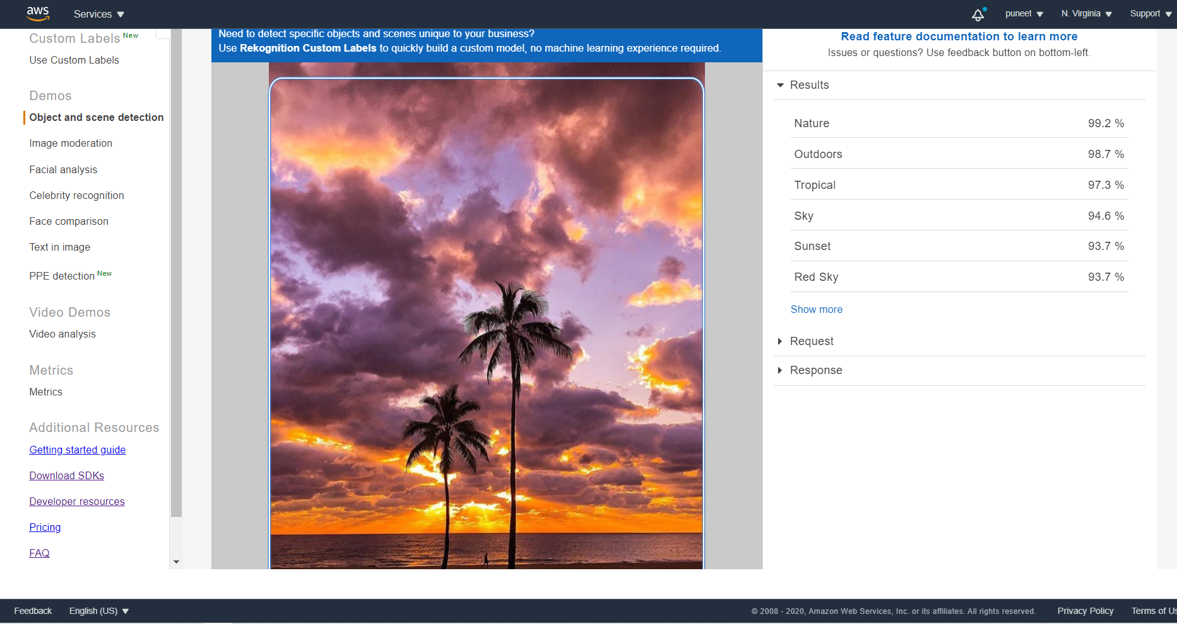
AWS REKOGNITION:

Slide 14
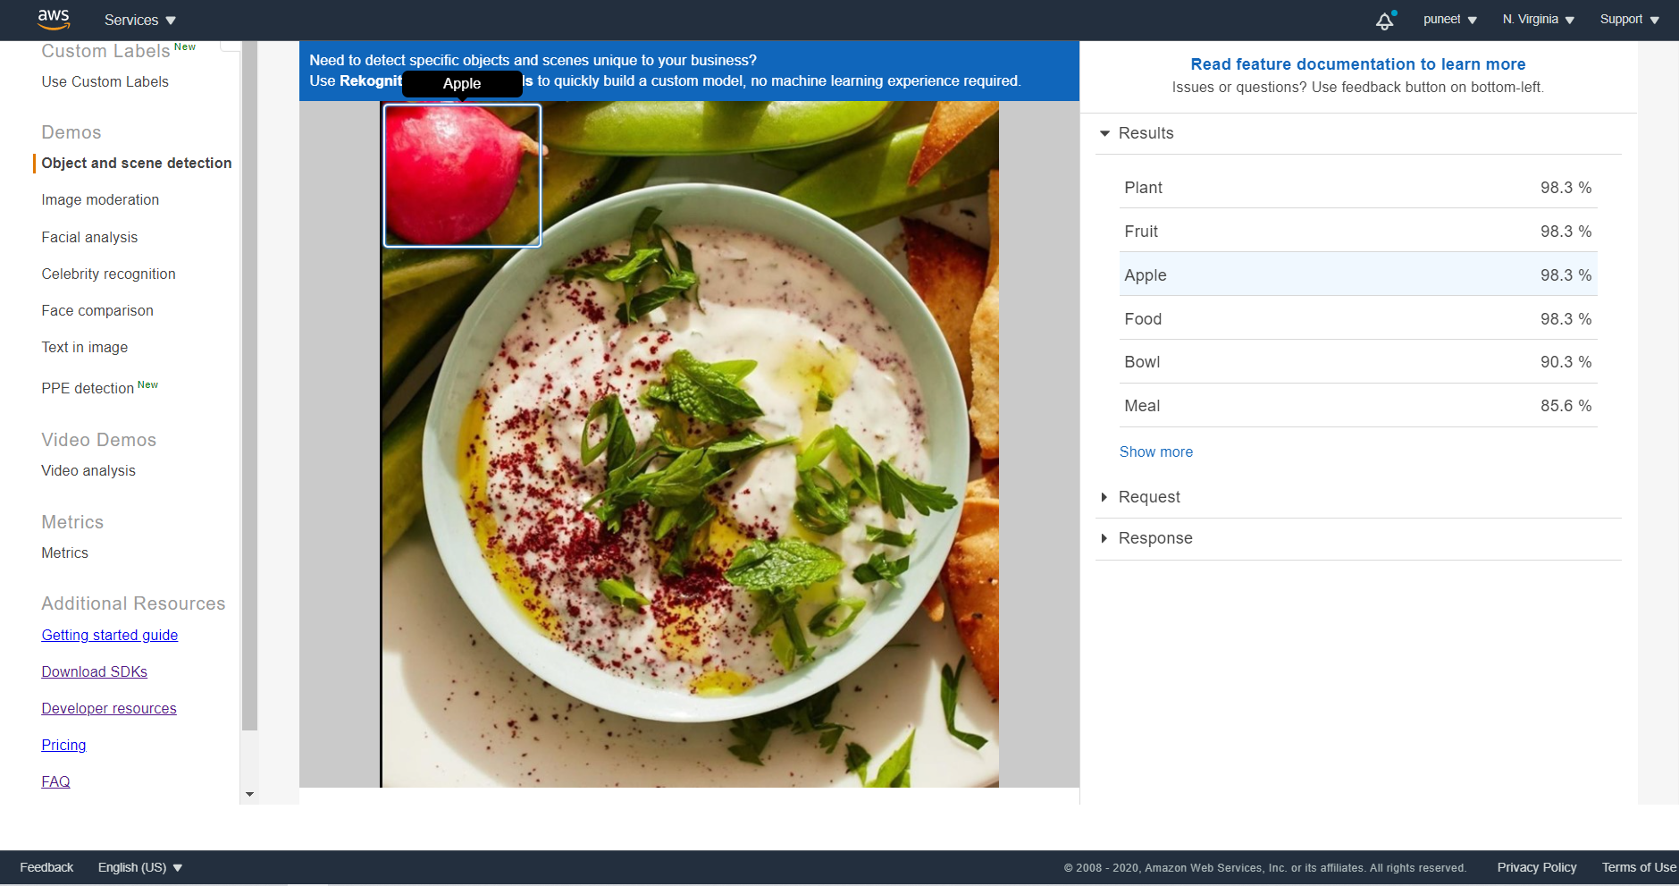
AWS REKOGNITION:

Slide 15
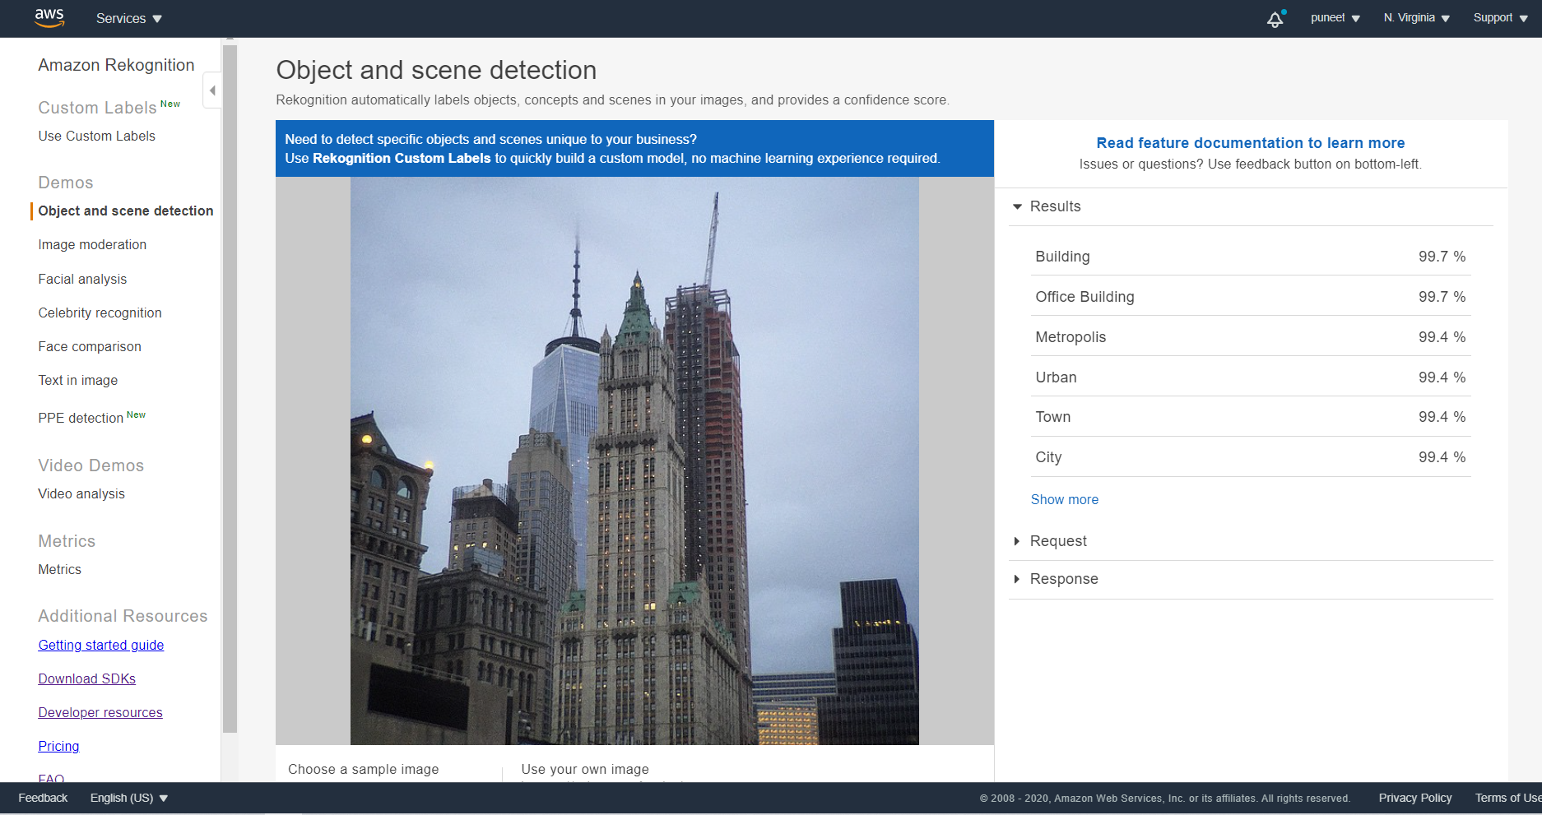
AWS REKOGNITION:

Slide 16
AWS REKOGNITION:
Request –
{ "Image": { "Bytes": "..." } }
Response –
{ "Labels": [
{ "Name": "Office Building",
"Confidence": 99.71690368652344, "Instances": [],
"Parents": [ { "Name": "Building" } ] }, { "Name": "Building",
"Confidence": 99.71690368652344, "Instances": [],
"Parents": [] },….

Slide 17
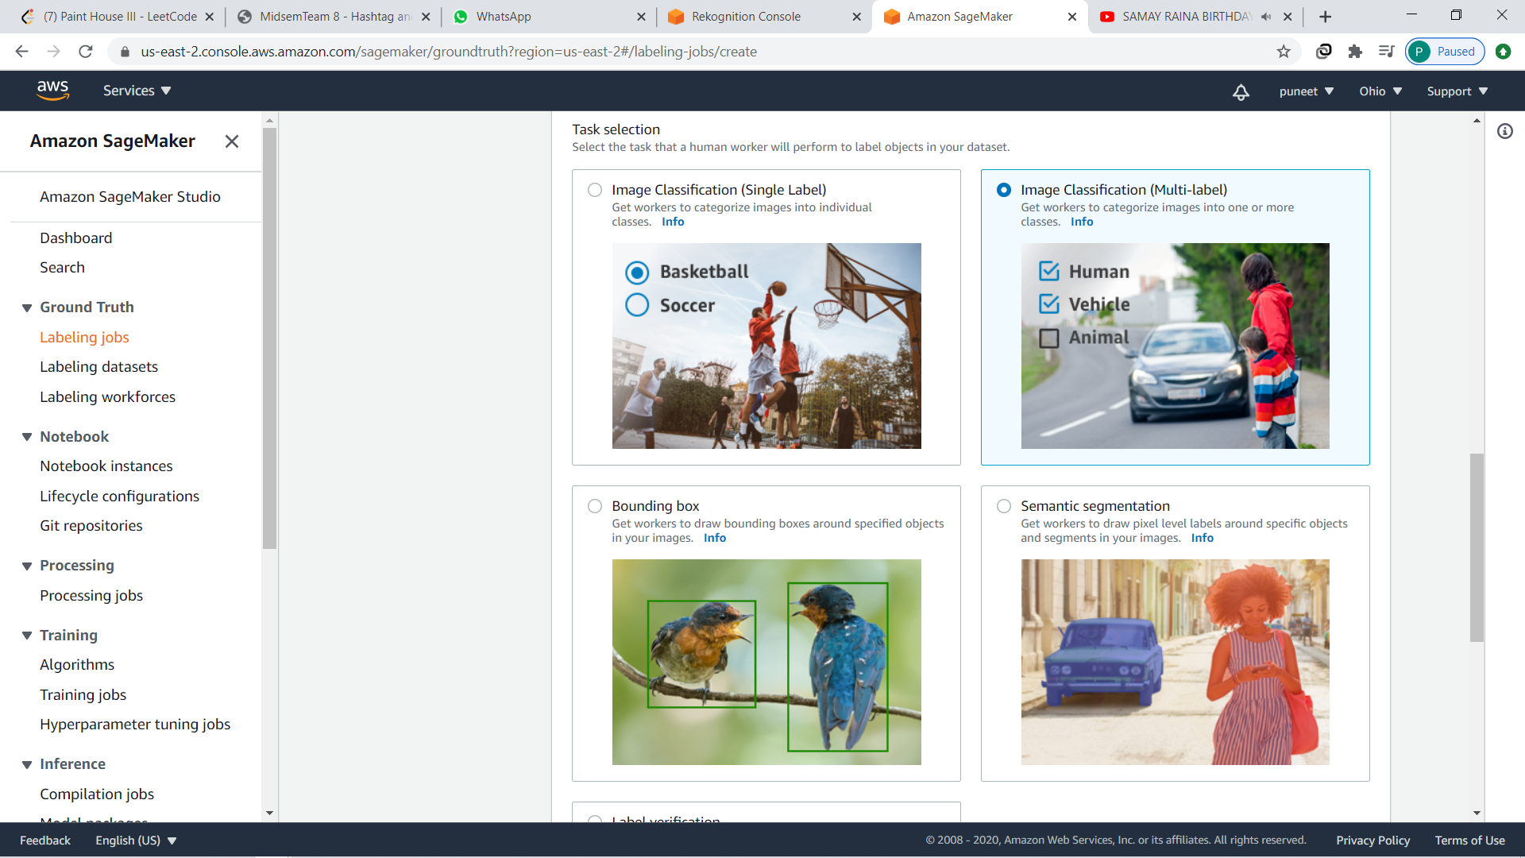
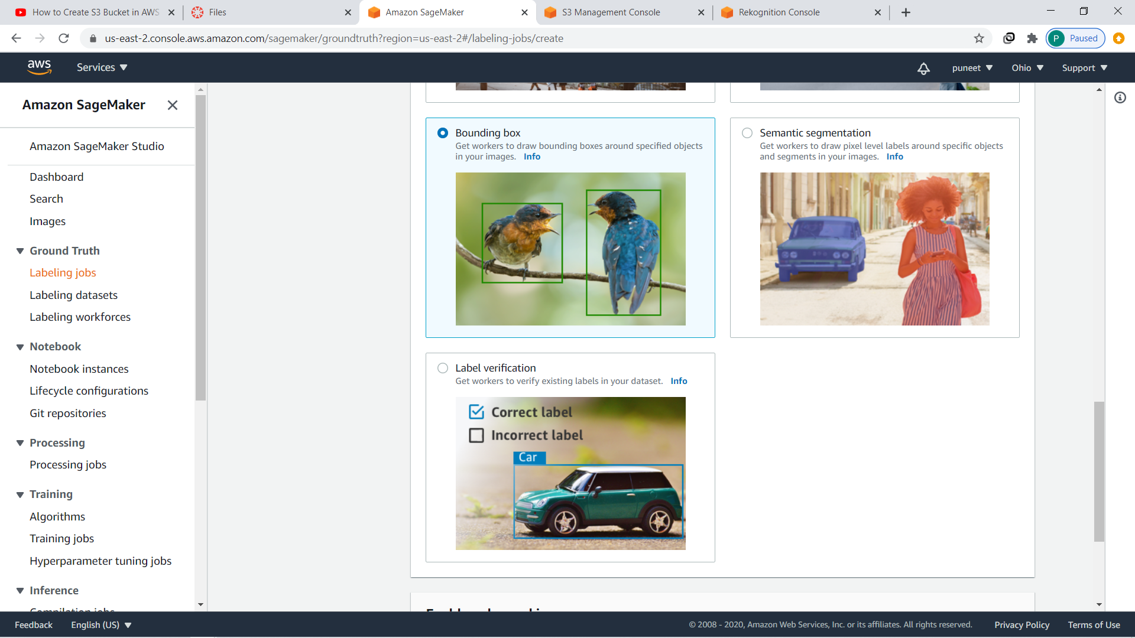
AWS SAGEMAKER (GROUND TRUTH):

Slide 18
DEMO
http://3.93.47.197/

Slide 19
REFERENCES
Li-Jia Li, Li Fei-Fei, (2009, June 18). OPTIMOL: Automatic Online Picture Collection via Incremental Model Learning. Springer Science + Business Media, LLC 2009.
https://aws.amazon.com/rekognition/resources/
https://docs.aws.amazon.com/rekognition/latest/dg/rekognition-dg.pdf
https://docs.aws.amazon.com/sagemaker/latest/dg/sagemaker-dg.pdf

Slide 20


